Slide 1
MLIoT: An End-to-End Machine Learning System for the Internet-of-Things
Presented by: Prashant Kumar(231110036)
Notes:
Entered text
Abstarct: Modern Internet of Things (IoT) applications, from contextual sensing to voice assistants, rely on ML-based training and serving systems using pre-trained models to render predictions. However,real-world IoT environments are diverse, with rich IoT sensors and need ML models to be personalized for each setting using relatively less training data. Most existing general-purpose ML systems are optimized for specific and dedicated hardware resources and do not adapt to changing resources and different IoT application requirements. To address this gap, we propose MLIoT, an end-to-end Machine Learning System tailored towards supporting the entire lifecycle of IoT applications. MLIoT also adapts to changes in IoT environments or compute resources by enabling re-training, and updating models served on the fly while maintaining accuracy and performance. evaluation across a set of benchmarks show that MLIoT can handle multiple IoT tasks, each with individual requirements, in a scalable manner while maintaining high accuracy and performance. We compare MLIoT with two state-of-the-art hand-tuned systems and a commercial ML system showing that MLIoT improves accuracy from 50% - 75% while reducing or maintaining latency
CHALLENGES
(i)Activity Recognition using Multi-Modal sensors
(ii) Audio Based Activity Recognition
(iii) Object Recognition using Image Data
(iv) Adapting to Different IoT Application requirements
(v) Adapting to Device Capabilities and Resource Availability
(vi) Adapting to Changes in Environmental Context
(v) Need for an End-to-End ML service for IoT
Implementation:
ensure cross-platform support to run on different devices, extensibility to add different models and frameworks, implemented
MLIoT in Python 3 given, efficient communication between the different components,
in a distributed setting, selecting Google’s gRPC given its maturity, efficiency, scalability, and cross-platform support[29].we use gRPC Protocol Buffers (Protobuf) extensively for this purpose, again due to its maturity. Additionally, each component is authenticated with each other using gRPCs built-in security primitives. The Device Selection Layer(DSL) also uses a MongoDB data storage layer to store persistent models, training data, and any other state about individual Training Serving Workers. This DB also stores device metrics and other metadata received from the Training Serving Layers. Overall, our implementation of MLIoT is 28,241 lines of code in Python.
Entered text
Abstarct: Modern Internet of Things (IoT) applications, from contextual sensing to voice assistants, rely on ML-based training and serving systems using pre-trained models to render predictions. However,real-world IoT environments are diverse, with rich IoT sensors and need ML models to be personalized for each setting using relatively less training data. Most existing general-purpose ML systems are optimized for specific and dedicated hardware resources and do not adapt to changing resources and different IoT application requirements. To address this gap, we propose MLIoT, an end-to-end Machine Learning System tailored towards supporting the entire lifecycle of IoT applications. MLIoT also adapts to changes in IoT environments or compute resources by enabling re-training, and updating models served on the fly while maintaining accuracy and performance. evaluation across a set of benchmarks show that MLIoT can handle multiple IoT tasks, each with individual requirements, in a scalable manner while maintaining high accuracy and performance. We compare MLIoT with two state-of-the-art hand-tuned systems and a commercial ML system showing that MLIoT improves accuracy from 50% - 75% while reducing or maintaining latency
CHALLENGES
(i)Activity Recognition using Multi-Modal sensors
(ii) Audio Based Activity Recognition
(iii) Object Recognition using Image Data
(iv) Adapting to Different IoT Application requirements
(v) Adapting to Device Capabilities and Resource Availability
(vi) Adapting to Changes in Environmental Context
(v) Need for an End-to-End ML service for IoT
Implementation:
ensure cross-platform support to run on different devices, extensibility to add different models and frameworks, implemented
MLIoT in Python 3 given, efficient communication between the different components,
in a distributed setting, selecting Google’s gRPC given its maturity, efficiency, scalability, and cross-platform support[29].we use gRPC Protocol Buffers (Protobuf) extensively for this purpose, again due to its maturity. Additionally, each component is authenticated with each other using gRPCs built-in security primitives. The Device Selection Layer(DSL) also uses a MongoDB data storage layer to store persistent models, training data, and any other state about individual Training Serving Workers. This DB also stores device metrics and other metadata received from the Training Serving Layers. Overall, our implementation of MLIoT is 28,241 lines of code in Python.

Slide 2
Introduction:
Challenge: IoT applications demand ML models for diverse tasks but struggle with variability in data sources and compute resources.
To address this gap: Introducing MLIoT, an adaptive end-to-end Machine Learning System tailored for IoT lifecycles.

Slide 3
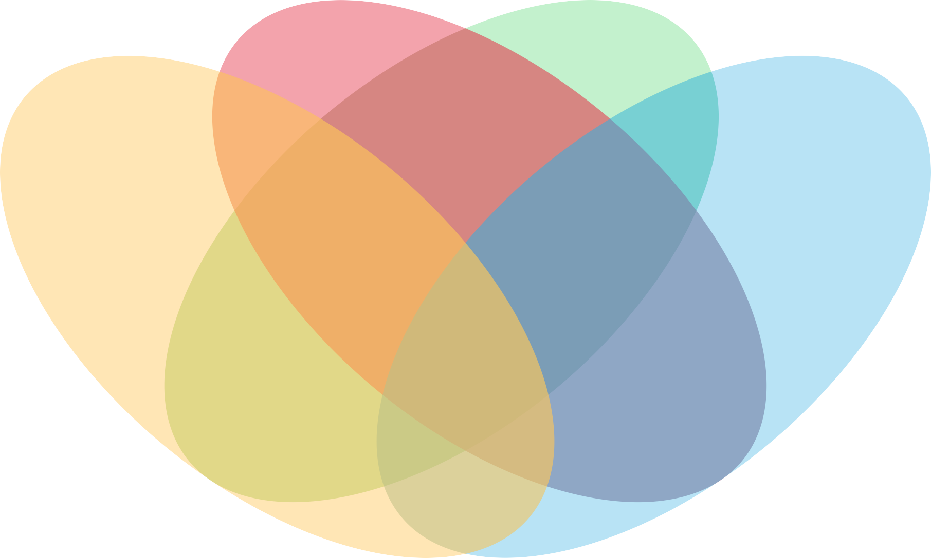
Application and Challenges:
Adapting to Changes
IoT Application Workloads
Smart Home/Buildings
Adapting to Device Capabilities and Resource Availability
Challenges for ML systems in IoT settings
Smart Assistance
Deep learning based computer vision applications
Activity Recognition
Object Recognition using Image Data
Deep learning based computer vision applications

Slide 4
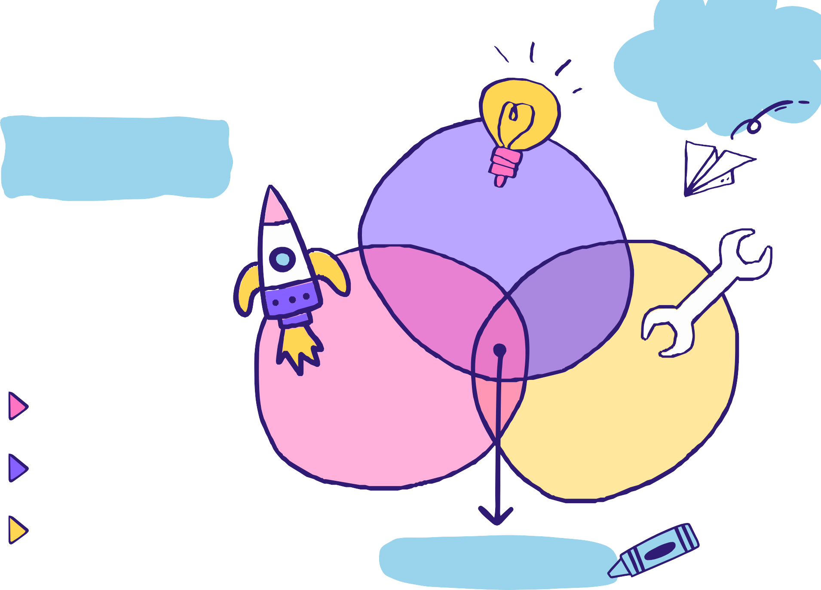
Related Work:
Large-scale ML Training Systems
ML Training/Serving Hybrid Systems
Large-scale ML Serving Systems
General purpose prediction
serving systems
Training focused systems optimize for DNN models with many HP
Development through a general-purpose ML system with both models
MLIoT

Slide 5
Proposed Approach(Hybrid Training Model):
Proposing MLIoT, an adaptive end-to-end Machine Learning System designed to cater to the diverse requirements of real-world IoT applications. MLIoT integrates expressive application-specific policies, automating training, optimization, and serving processes to handle varied IoT data sources, tasks, and compute resources.
MLIoT's unique approach involves on-the-fly re-training and model updates, ensuring continual adaptation to changing IoT environments and compute resources while maintaining high accuracy and performance, as demonstrated through a benchmark evaluation showcasing substantial accuracy improvements (50% - 75%) with reduced or maintained latency compared to existing systems.

Slide 6
Features of Proposed Approach:
MLIoT provides flexible policy-driven selection of hardware platforms,resources and models
Provides end-to-end solutions for Supporting the lifecycle of an IoT application
MLIoT is able to service policy objectives, balancing load across devices while maintaining accuracy and latency
MLIoT
Provides Lazy training facility to start predicting fast and become more accurate gradually
MLIoT competes to state of the art systems in terms of accuracy and performance.

Slide 7
Continued…
Cross-platform support for diverse devices.
Extensibility to incorporate various models and frameworks.
Implemented in Python 3 for popularity and robust ML support.
Employed gRPC Protocol Buffers (Protobuf) for extensive data and model exchange due to its maturity.
Each component authenticated using gRPC's built-in security primitives.
Device Selection Layer (DSL) utilizes MongoDB for storing persistent models, training data, and other state information about individual Training Serving Workers.

Slide 8
SYSTEM DESIGN AND ARCHITECTURE
Implementation:
MLIoT is designed to empower the Internet of Things (IoT) landscape by seamlessly integrating Machine Learning (ML) capabilities.
Consists of two fundamental components: the Device Selection Layer (DSL) and the Training-Serving Layer (TSL).
TSL
DSL
Central Authority
Task Handling
Configuration Management
Benchmarking
Task Management
Resource Allocation
Model Optimization
Metrics Reporting

Slide 9
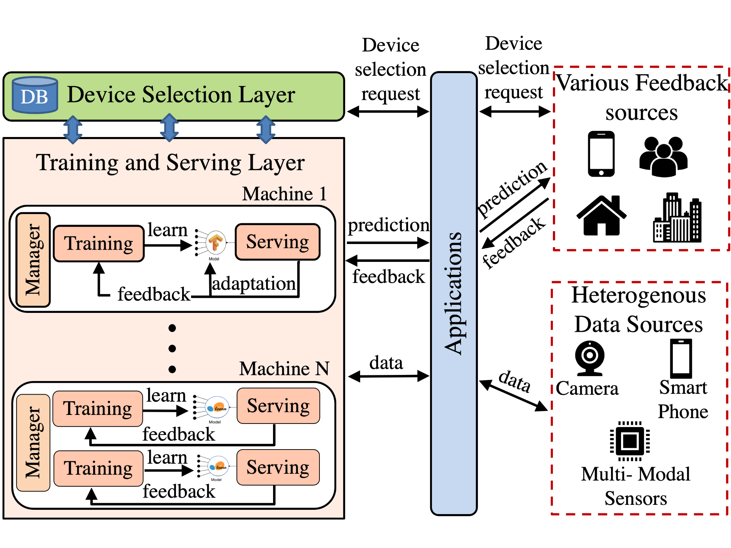
System Architecture of MLIoT:

Slide 10
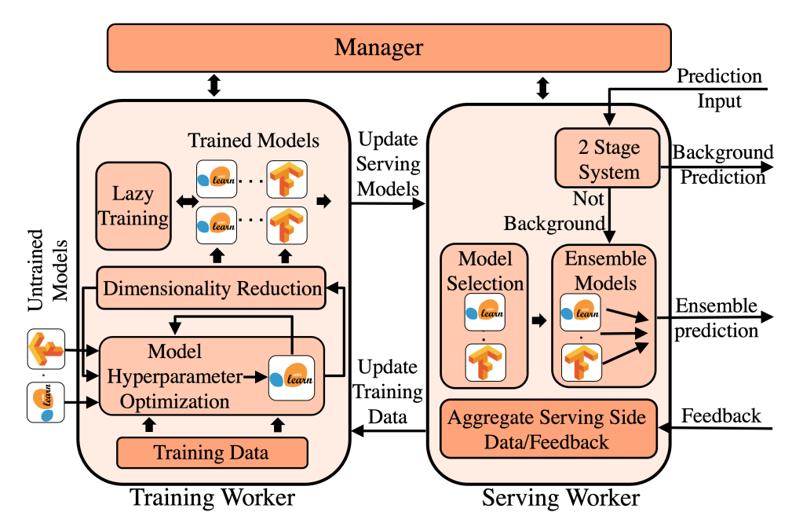
Training and Serving Workers overview:

Slide 11
DSL & TSL:
Training Worker
Serving Worker
Responsible for prediction based on the models included in the ensemble
Two-Stage Serving
Prediction Confidence
Performance hinges on device capabilities
Device Selection Layer (DSL) monitors and schedules IoT tasks across devices
Benchmarks devices using representative IoT datasets
Metrics include CPU/memory utilization, prediction latency, training time, and accuracy.
Streamline model training to provide high-quality ML models.
Dimensionality Reduction
Hyper-parameter optimization
Lazy training

Slide 12

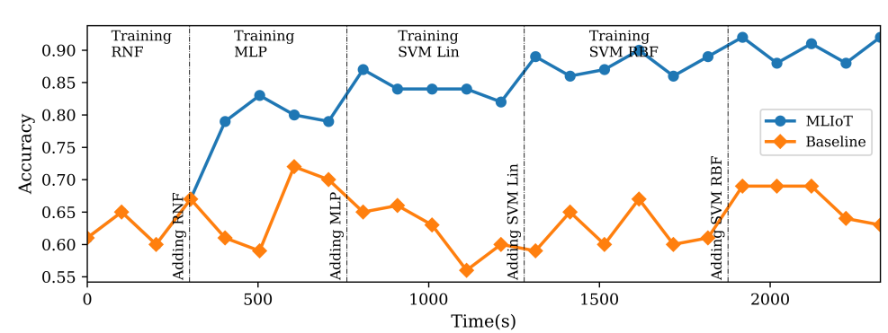
Evaluation:
MLIoT undergoes evaluation across representative IoT benchmarks, diverse hardware platforms, and varying application needs, and the results are-
>>Here only accuracy is shown, but MLIoT performs better than state-of-art systems in other metrics too.

Slide 13
Future Scope:
Future work could extend MLIoT's capabilities by exploring enhanced integration with emerging IoT technologies, further refining its adaptability to evolving IoT landscapes.
Additionally, avenues for improvement may include research into optimizing resource allocation algorithms and extending support for even more diverse IoT applications and use cases.

Slide 14


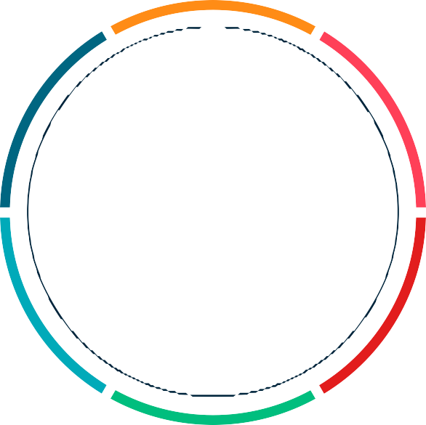




DATA 01
DATA 04
MLIoT is an end-to-end Machine Learning System designed for the complete IoT lifecycle
Better performance and resource utilization than state-of-art systems.
DATA 02
MLIoT offering effective load balancing across devices without compromising accuracy .
DATA 05
Integration of multiple distributed components , optimization techniques
Conclusion
DATA 03
Evaluations on various hardware devices and expressive IoT.
DATA 06
MLIoT offers flexible, policy-driven selection of hardware platforms

Slide 15
References:
[1]: Sudershan Boovaraghavan, Anurag Maravi, Prahaladha Mallela, and Yuvraj Agarwal. 2021. MLIoT: An End-to-End Machine Learning System for the Internet-of-Things. In Proceedings of the International Conference on Internet-of-Things Design and Implementation (IoTDI '21). Association for Computing Machinery, New York, NY, USA, 169–181. https://doi.org/10.1145/3450268.3453522

Slide 16
Thank you for your time 😊

